Slide 1

Origin Pilot The First Quantum Operating System
Caden W. Clements
CSC 9010: Program Quantum Computers
Final Project

Slide 2
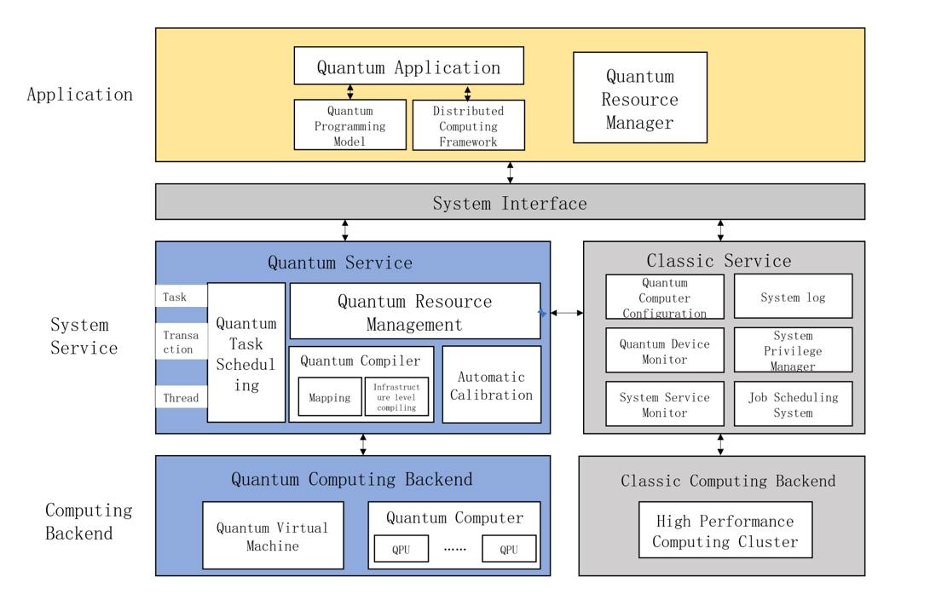
Introduction
Launched in 2021 by Origin Quantum
China’s first Quantum Operating system
Now: Central command hub for China’s quantum computing Operations
Hardware Integration:
Superconducting, Trapped ions, Semiconductors, Neutral atoms, and Photonics.
Supporting different computing backends:
quantum processors, quantum virtual machines and high-performance computing clusters
Notes:
Overview
Launched in 2021 by Origin Quantum
Known as China's first quantum computer operating system
Acts as a central command hub for quantum computing operations and scheduling
Hardware Integration (Downstream)
Provides unified access to multiple quantum hardware types:
Superconducting circuits
Trapped ions
Semiconductors
Neutral atoms
Photonics
Contributions of Origin Pilot
Calibrate one or many qubits without interrupting other circuits
Ensuring it is in the correct starting state – CHECK FOR THIS
can allocate quantum resources for quantum circuits according to the state of the quantum resources and the requirements of quantum circuits
Reduce the decoherent noise with dynamic decoupling in qubits

Slide 3
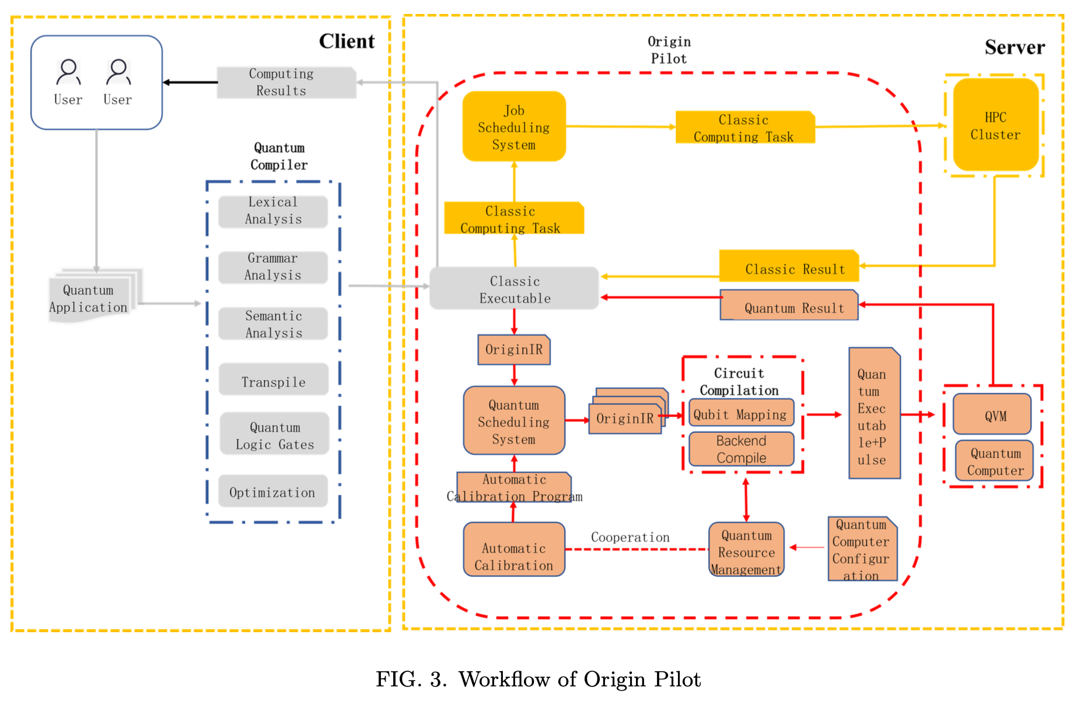

Task Scheduling
Multiple tasks on multiple processors.
Elements of a quantum task
# of qubits
a programs intermediate representation
Processor’s ID
Type of task: General or a calibration task
Priority of the task
Highest Response Ratio Next – HRRN
$R_{p}=\frac{ T_{waiting_{t}ime} +{ T}_{runtime}}{ T_{runtime}} = \frac{T_{response_{t}ime}}{T_{runtime}}$
Notes:
Scheduling multiple quantum tasks on multiple quantum processors
Quantum task elements
(1) The number of qubits required for a quantum task;
(2) Quantum program’s intermediate representation;
(3) Quantum processor’s ID;
(4) Type of a quantum task: a quantum task can be a general quantum task or automatic calibration task;
(5) Priority: The priority of a quantum task.
Hightest Response Ratio Next – HRRN
$R_{p}=\frac{ T_{waiting_{t}ime} +{ T}_{runtime}}{ T_{runtime}} = \frac{T_{response_{t}ime}}{T_{runtime}}$
Some of the classical algorithms include
First come first serve
Shortest Job First

Slide 4
Parallel Execution
Qubit mapping as token-swap problem (minimize SWAPs)
SWAPs add noise
prioritize high-fidelity paths
Tasks run as transactions (parallel scheduled, one executes)
Map logical
physical qubits using hardware topology
Calibration tasks: high priority, no mapping, no interference
Use FCFS scheduling
Program → DAG → optimal execution order
Notes:
Qubit mapping is treated as a token-swap problem, where minimizing SWAP gates is critical due to added error and exponential complexity.
SWAP gates introduce additional noise, so mapping aims to both reduce swaps and choose routes with the highest fidelity.
Quantum tasks are scheduled and executed in parallel using transactions, but only one transaction runs at a time.
Before execution, logical qubits must be mapped to physical qubits based on the processor’s topology.
Automatic calibration tasks are given higher priority and do not require qubit mapping, preventing interference with other tasks.
Calibration tasks follow a First-Come-First-Served (FCFS) scheduling strategy.
The mapping process involves converting the quantum program into a Directed Acyclic Graph (DAG) and identifying optimal subgraph sequences.

Slide 5
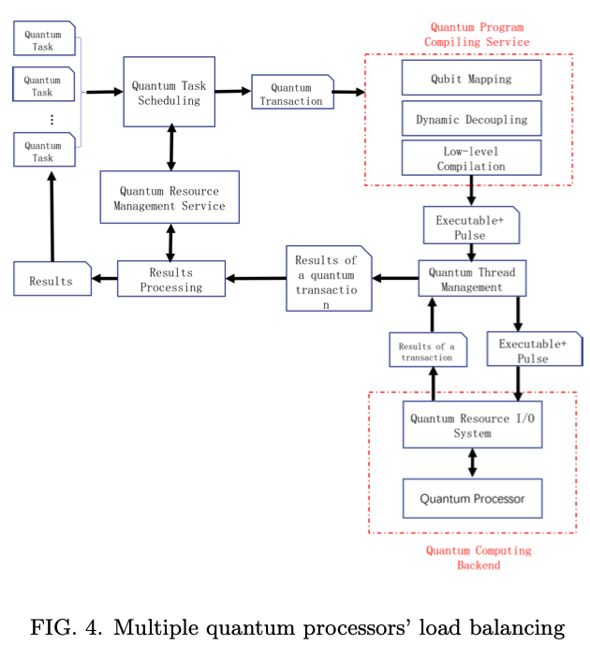
Automatic Calibration
Coherence time can help derive coupling strength between the system and quantum environment
Qubit quality is affected by multiple factors
Automatic calibration is required
Calibration Steps
Performance checking
Error adjustment
Processors splits tasks in different regions
Improving fidelity
Notes:
Automatic Callibration
Qubits’ coherence time can be used to describe the coupling strength between a quantum system and the environment.
The longer they hold the state the better it gets
Magnetic can disturb the envirornment
Qubit quality depends on multiple factors, so continuous calibration is required.
Calibration has two steps: check performance → adjust errors.
Uses a POMDP model to automate calibration decisions.
A Partially Observable Markov Decision Process (POMDP) models calibration by letting an agent use noisy measurement observations to infer hidden hardware states and choose actions that maximize fidelity while minimizing calibration cost over time.
Processor is split into execution and calibration regions.
Tasks run on the best-performing region, improving fidelity.

Slide 6
Conclusions
Still in early stages
Core features accomplished
task scheduling, parallel execution, and calibration.
Resource Management
Another accomplishment but not in this presentation
Future work focus on bridges between quantum and Classical
Origin Pilot is available for download!
open-source ecosystem development
Notes:
Conclusions
Quantum operating systems are still early-stage research.
Origin Pilot provides core features: task scheduling, resource management, parallel execution, and calibration.
Future work includes distributed quantum computing and hybrid classical-quantum systems.
Plans to release the source code publicly for non-commercial use.

Slide 7
References
“Origin Pilot: a Quantum Operating System for Efficient Usage of Quantum Resources,” Origin Quantum, accessed April 23, 2026, https://originqc.com/blogs/origin-pilot-download.
“Chinese Firm Releases Open-Source Quantum Operating System for Public Download,” The Quantum Insider, February 27, 2026, https://thequantuminsider.com/2026/02/27/chinese-firm-releases-open-source-quantum-operating-system-for-public-download/.
Kong, Weicheng, Junchao Wang, Yongjian Han, Yuchun Wu, Yu Zhang, Menghan Dou, Yuan Fang, and Guoping Guo. "Origin pilot: a quantum operating system for effecient usage of quantum resources." arXiv preprint arXiv:2105.10730 (2021), pg 6.

